Slide 1




Slide 2
What is >log on | move on>?
A free and impartial education, training and careers website helping young people in our area plan their next steps after school
  Learn about yourself and your strengths, skills, and aspirations
  Research and apply for courses and apprenticeships
  Complete the Skills Passport and use the CV builder tool
You can access >log on | move on> at home, at school, or on mobile devices
You do not need log in details to access the main information pages, you will only need to log in to access your account
It's a quick and easy way to apply to more than one provider and track all applications in one place and you take your account with you when you move on to the next step in your training and education journey
Notes:
Partnership between ERYC, HCC, post 16 providers, and schools
What does impartial mean?
- We are not linked to any of the 6th forms, colleges or training providers, we treat them all equally. So you can be sure that all of the information we post is unbiased.

Slide 3
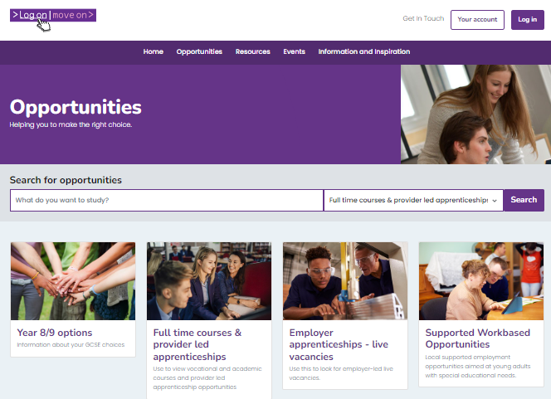
Opportunities
‘Opportunities’ are the options available to you after you leave Year 11
Full time courses and provider led apprenticeships normally start in September
Employer apprenticeships start whenever a business has a vacancy
Search by:
  Provider
  Area
  Qualification
  Sector/subject

Slide 4
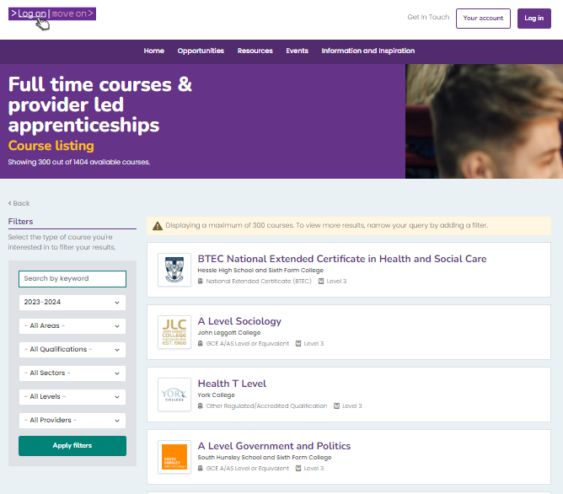
Opportunities
Use the filters to narrow down your search if you want to
If you don’t know what you want to do, just clicking on ‘search’ will show you a list of everything. Try thinking about your favourite subjects at school, or things you like doing outside of school

Slide 5
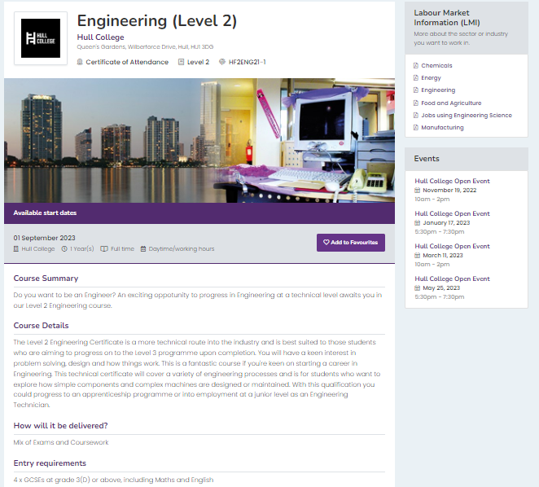
Opportunities
Click on the title to find out:
Where, when, duration and qualification
What you will study, and how it will be taught
Entry requirements
Labour Market Information (LMI)
Relevant events
  ‘Add to favourites’
  When you’re logged in, add your preferred opportunities to your favourites list to quickly apply for them later
Notes:
Notes:
What are entry requirements?
The subjects and grades you might need to get a place on your chosen course or apprenticeship
What is LMI?
- The types of industries and jobs this opportunity might lead you to, how much you could expect to earn, and the local employers within this industry

Slide 6
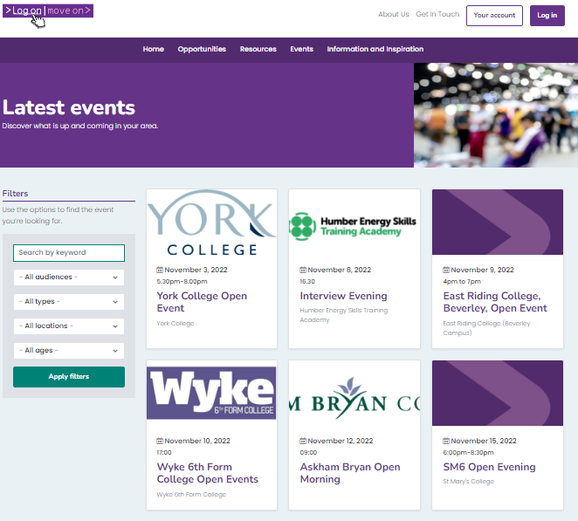
Events
It is really important that you visit the different providers. You could be spending the next few years with them, make sure you think you will be happy and supported
Notes:
Notes:

Slide 7
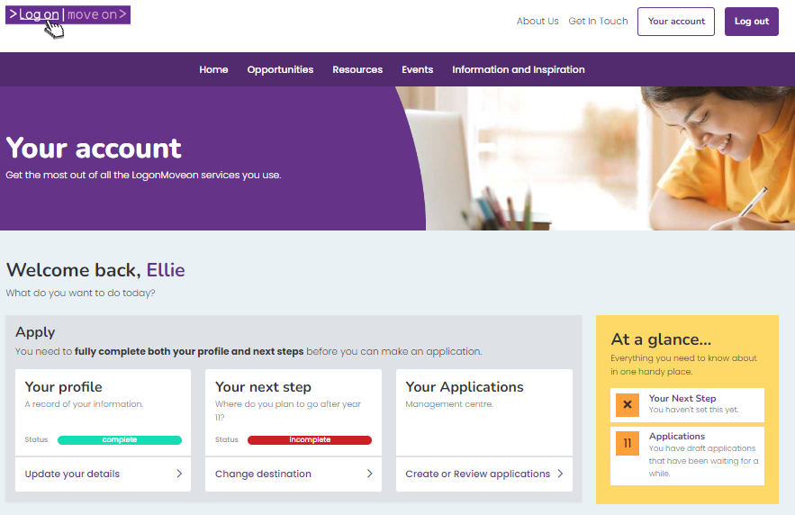
Your account
Complete ‘Your Profile’ information
Use capital letters and correct grammar – this information is used in your applications
‘Your next step’ is what your plans are after Y11. You can edit this if you change your mind
Notes:
Notes:

Slide 8
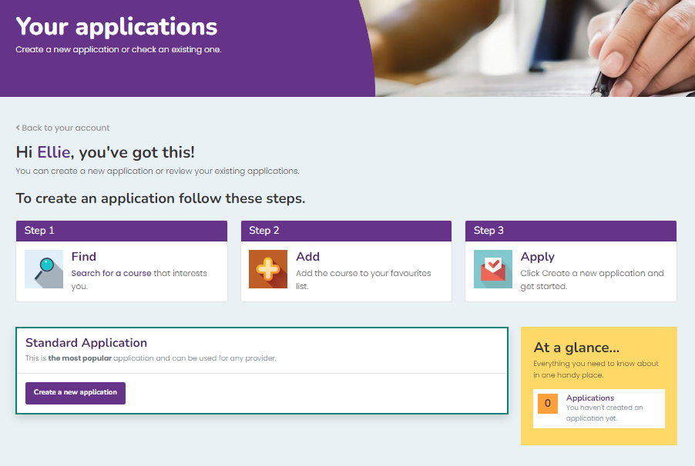
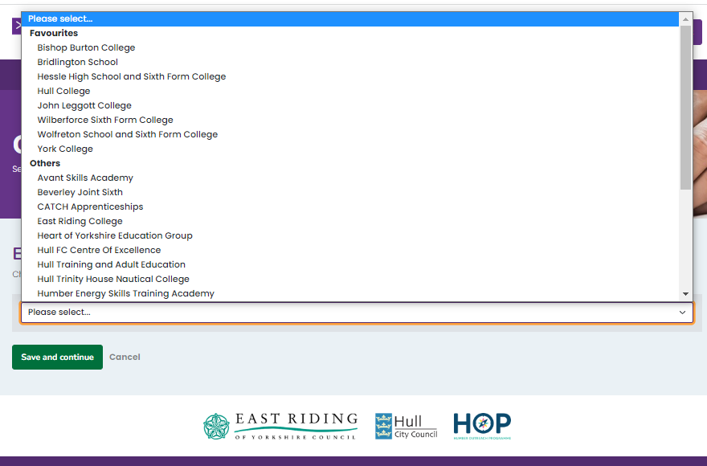
Applications
When you have researched your courses and added them to your favourites, you can start your applications.
We recommend having a ‘plan A’ and a ‘plan B’
The providers offering your ‘favourited’ courses will be at the top of the drop down menu
Notes:
Notes:

Slide 9
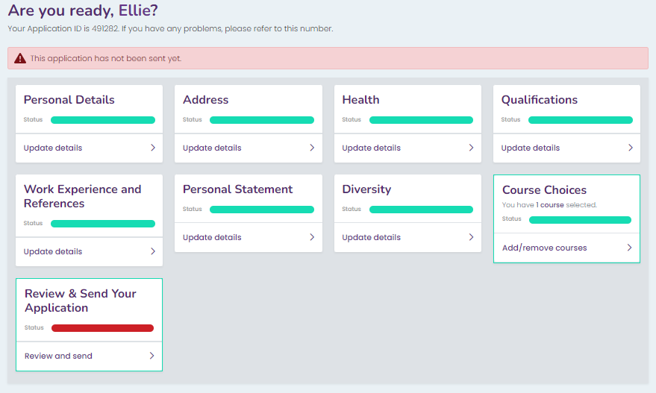
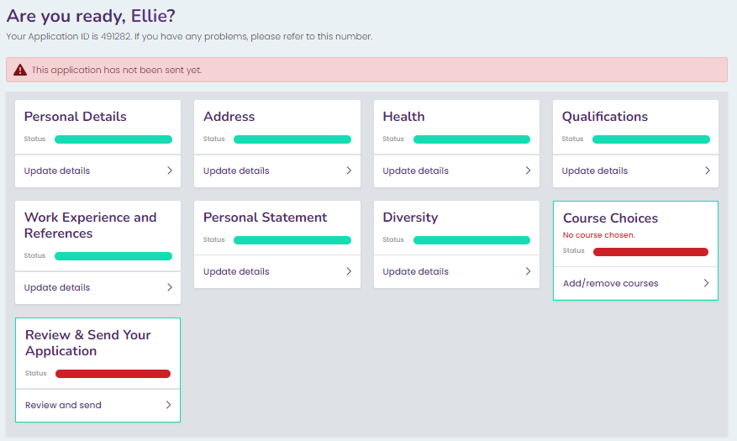
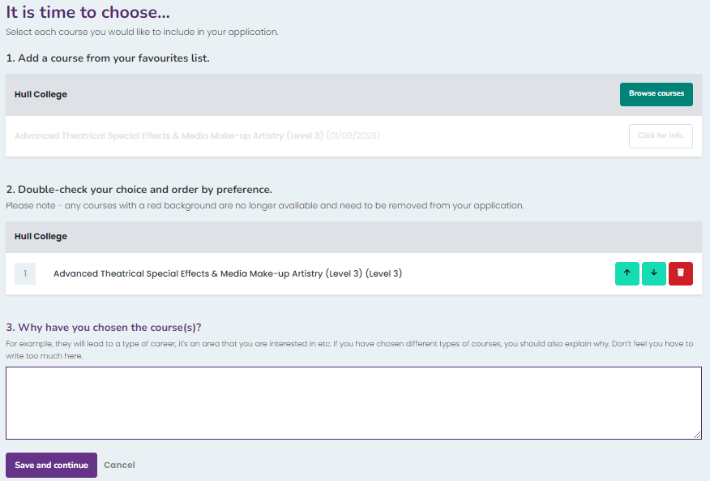
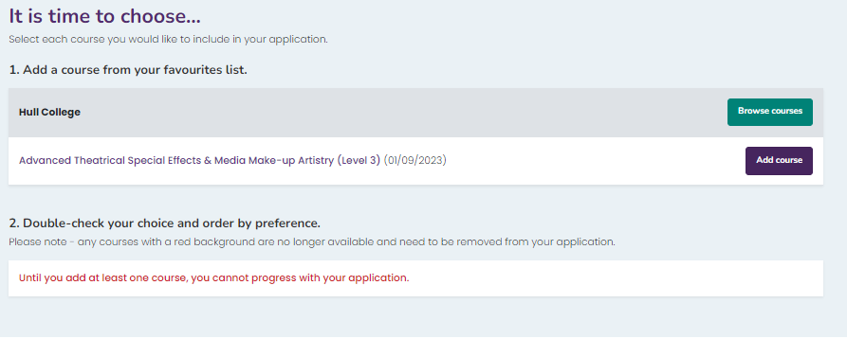
Applications
Your application pages pull through all of your personal details from your main account
Add your opportunity
Explain why you would like to a place on this course or apprenticeship
Notes:
Notes:

Slide 10
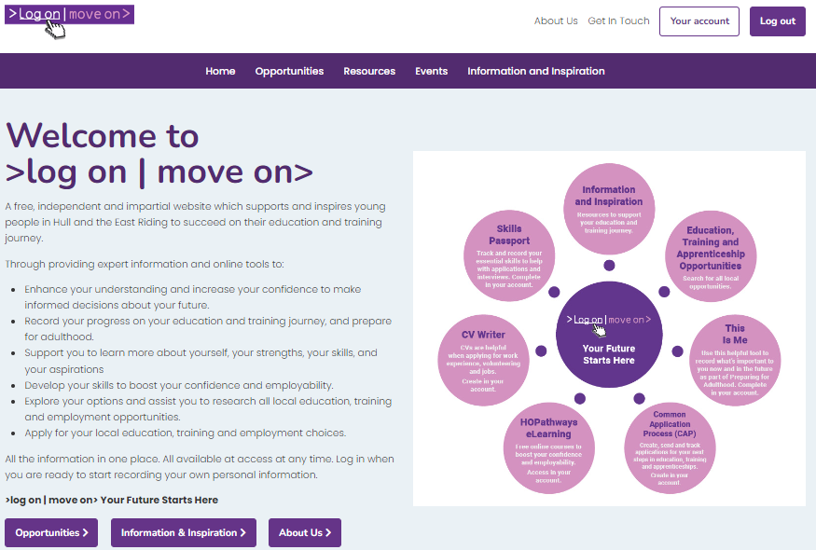
Get in touch
Our team are happy to help if you have any problems, use the ‘Get in touch’ button at the top of the page to send us a message
Notes:
Notes:

